Slide 1
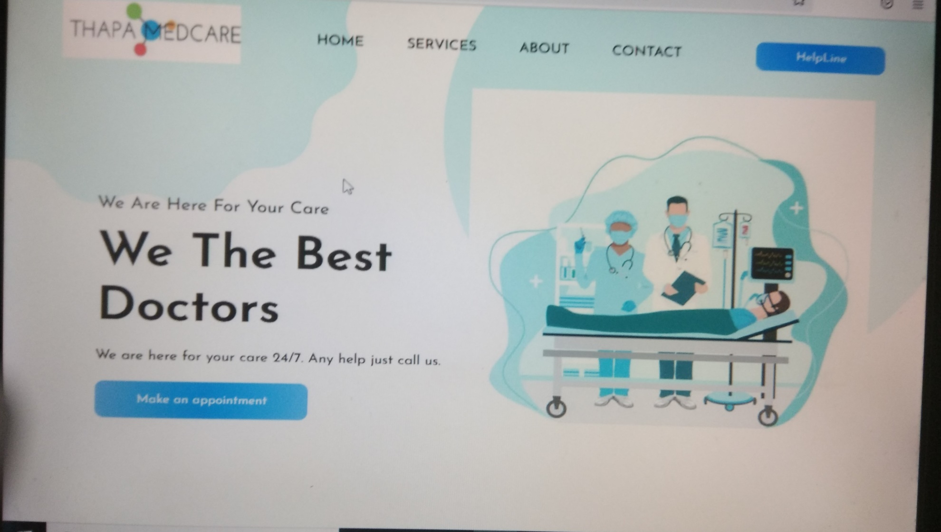
CLINIC WEBSITE web development based project Developed by:- BIDISHA CHOWDHURY

Slide 2
OVERVIEW
Clinical documentation (CD) is the creation of a digital or analog record detailing a medical treatment, medical trial or clinical test. Clinical documents must be accurate, timely and reflect specific services provided to a patient.
The General Medical Council (GMC) outlines the requirements within Good Medical Practice , stating that one must, "keep clear, accurate, and legible notes, report relevant clinical findings, document decisions made and by whom, document the information given to patients, document any drugs or other treatment.

Slide 3
OBJECTIVE
Clinical management means the programs that apply systems, science, incentives, and information to improve medical practice and assist both consumers and their support system to become engaged in a collaborative process designed to manage medical/social/behavioral health conditions more effectively.

Slide 4
SOFTWARE REQUIREMENTS
Text Editor:
VISUAL STUDIO
FRONTEND:- BROWSER:
1. HTML GOOGLE CHROME
2. BOOTSTRAP

Slide 5
SYSTEM USER
Clinic management system improves the general efficiency of the organization by automating the entire system. The software helps in streamlining every element of a healthcare center. Some of which includes recordkeeping, printing out prescriptions, charting, scheduling patients' appointments, and billing functions.

Slide 6
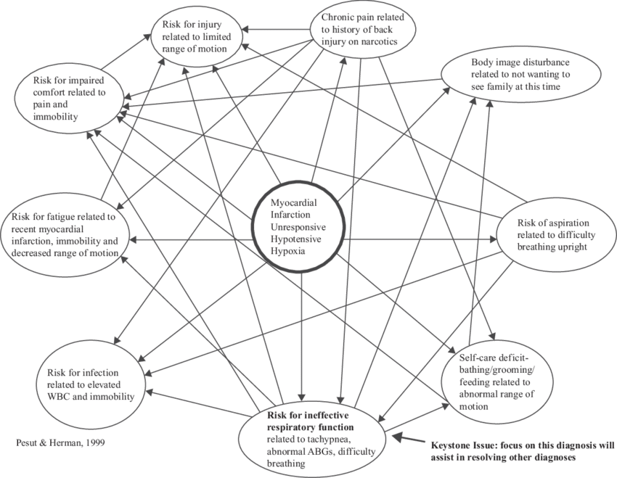
CLINICAL REASONING

Slide 7
THANK YOU

